Slide 1


Vector Search with OpenAI, Cosmos DB NoSQL API, and Cognitive Services
Azure Developer
Chris Joakim

Slide 2
Welcome
Presentation Outline

Slide 3
This Presentation
Vector Search in Microsoft Azure with:
Azure OpenAI
Azure Cosmos DB NoSQL API
Azure Cognitive Search
The Sean Lahman Baseball Database (CSV files)
Implemented with Python 3
Outline:
Concepts - Vectors, Vectorization, Vector Search
The Business Use-Case
The Implementation
Description

Slide 4
Concepts

Slide 5
Concepts
What is a Vector?
A Vector is a one-dimensional array of scalar values.
Think of them as a numpy array of floats
What is Vectorization?
Vectorization is the process of converting text data into vectors
These vectors are called embeddings in OpenAI
The OpenAI SDK contains the functionality to produce a vector, or an embedding, from text data
OpenAI’s text embeddings measure the relatedness of text strings
Embeddings are information-dense and are computationally efficient (but look verbose when printed)
They use Cosine similarity to measure semantic similarity
https://learn.microsoft.com/en-us/azure/ai-services/openai/
https://platform.openai.com/docs/libraries
https://platform.openai.com/docs/guides/embeddings/what-are-embeddings
Description

Slide 6
Concepts
[ -0.028514496982097626, 0.02490937151014805, -0.006417802534997463, ... -0.01409399788826704, -0.026895591989159584, -0.007012988440692425 ]
[ -0.028514496982097626, 0.02490937151014805, -0.006417802534997463, ... -0.01409399788826704, -0.026895591989159584, -0.007012988440692425 ]
What is Vector Search?
Searching a database, or search-engine, using vectors
A vector is passed in as the query criteria
The DB/engine matches rows/documents based on the given vector column/attribute in the DB
What does a Vector Look Like? (an array of 1536 floats in the range -1 to +1)
[
-0.028514496982097626,
0.02490937151014805,
-0.006417802534997463,
...
-0.01409399788826704,
-0.026895591989159584,
-0.007012988440692425
]
It looks very large and verbose when printed, but it's actually a very efficient data structure and it enables greater computational efficiency vs text data
Description

Slide 7
Concepts
[ -0.028514496982097626, 0.02490937151014805, -0.006417802534997463, ... -0.01409399788826704, -0.026895591989159584, -0.007012988440692425 ]
[ -0.028514496982097626, 0.02490937151014805, -0.006417802534997463, ... -0.01409399788826704, -0.026895591989159584, -0.007012988440692425 ]
What can I do with Vector Search?
Find images that are similar to a given image based on their visual content and style
Find documents that are similar to a given document based on their topic and sentiment
Find products that are similar to a given product based on their features and ratings
In short, many use-cases. Including finding similar Baseball Players
But, IMO, it doesn't replace standard search. It augments it
Wait, why are we using Azure OpenAI here again?
To generate the vectors (i.e. – embeddings) from your text data input
OpenAI contains models like GPT-4 and DALL-E
But it also contains models like text-embedding-ada-002
https://platform.openai.com/docs/models
Description

Slide 8
The Business Use-Case

Slide 9
The Business Use-Case
This project is focused on Baseball data and matching Baseball Players
But the solution is applicable to many vector search use-cases
What's the Business Problem we're trying to solve?
While other search techniques can answer simple searches like:
Who hits home runs at a similar rate as Hank Aaron?
Who steals bases at a similar rate as Rickey Henderson?
Who has a similar pitching ERA (earned run average) as Ron Guidry?
This project instead seeks to answer this more complex question, using vector search:
Who has a similar OVERALL PERFORMANCE PROFILE as player x?
This type of search is more nuanced and subtle, but can yield more relevant search results.
Description

Slide 10
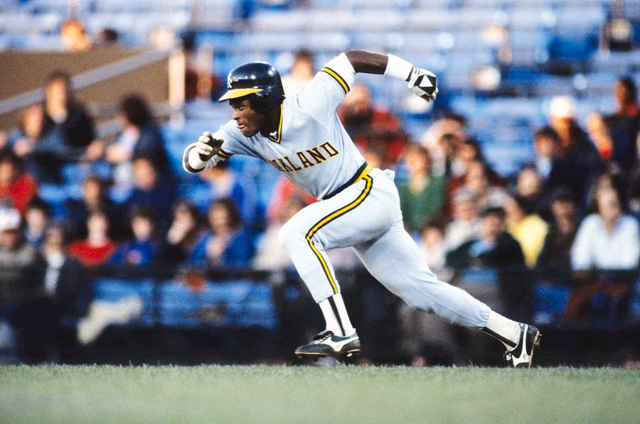
The Business Use-Case – Find Similar Baseball Players
Description
Meet Rickey Henderson, Hall of Fame Player, Statistical Unicorn - rare combination of speed and power
All-time MLB leader in stolen bases, by far
Also very high, statistically, in home runs, triples, walks, IBB, HBP, and runs

Slide 11
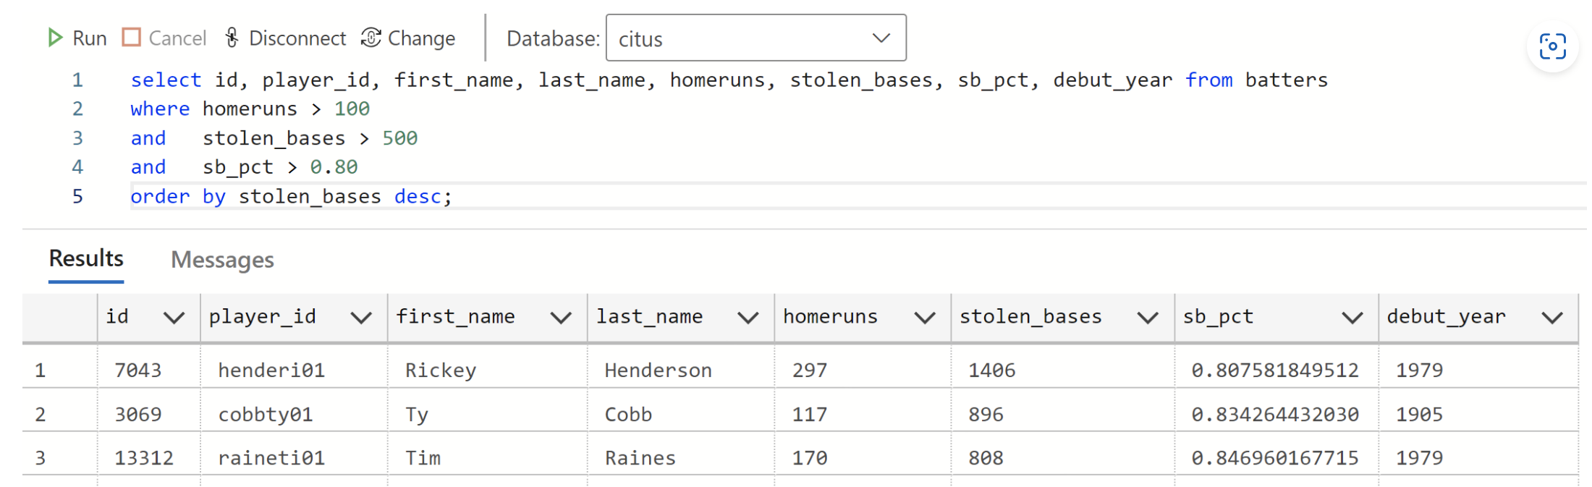
The Business Use-Case – Search (ex: Who could possibly be like Rickey Henderson?)
You can try to use a simplistic query (SQL is shown here) to identify similar players
But this WHERE clause only contains only three attributes ... it's not a "full-spectrum" query of the many dimensions of baseball player statistics
And YOU have to construct the query
With vector search you simply ask: Who is like Rickey Henderson? And you get pertinent results.
Description

Slide 12
The Implementation

Slide 13
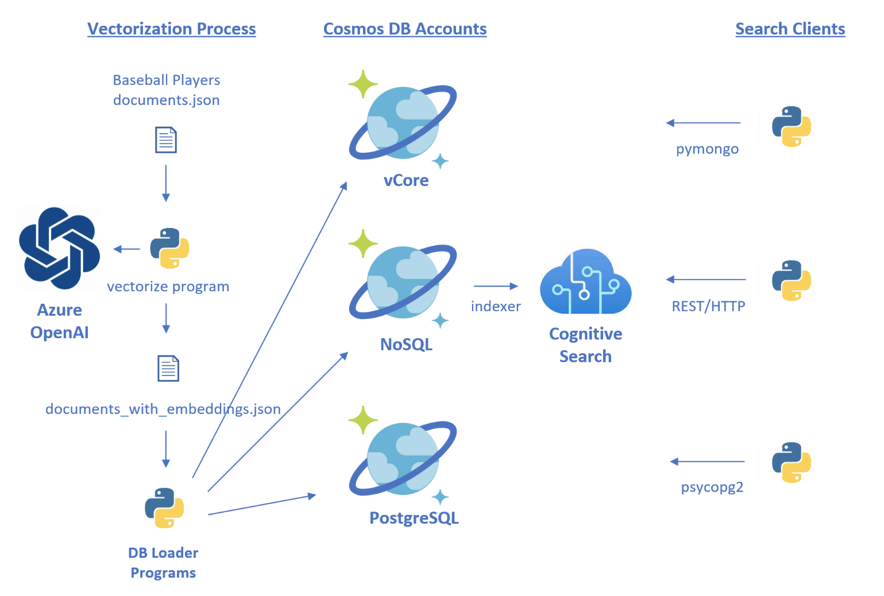
Implementation – In this Presentation we’ll focus on the NoSQL & Cognitive Search Path
Description

Slide 14
Implementation – Baseball Player Document, Part 1/4, Mostly from People.csv fields
{
"playerID": "henderi01",
"birthYear": 1958,
"birthCountry": "USA",
"deathYear": "",
"nameFirst": "Rickey",
"nameLast": "Henderson",
"weight": 180,
"height": 70,
"bats": "R",
"throws": "L",
"debut": "1979-06-24",
"finalGame": "2003-09-19",
"teams": {
"total_games": 3081,
"teams": {
"OAK": 1704,
"NYA": 596, …
},
"primary_team": "OAK"
},
"primary_position": "LF",
…
Description

Slide 15
Implementation – Baseball Player Document, Part 2/4, merged in Batting.csv fields
…
"batting": {
"G": 3081,
"AB": 10961,
"R": 2295,
"H": 3055,
"2B": 510,
"3B": 66,
"HR": 297,
"RBI": 1115,
"SB": 1406,
"CS": 335,
"BB": 2190,
"SO": 1694,
"IBB": 61,
"HBP": 98,
"SF": 67,
…
Description

Slide 16
Implementation – Baseball Player Document, Part 3/4, calculated fields
…
"batting": {
"calculated": {
"runs_per_ab": 0.20937870632241584,
"batting_avg": 0.2787154456710154,
"2b_avg": 0.046528601404981294,
"3b_avg": 0.006021348417115227,
"hr_avg": 0.027096067877018522,
"rbi_avg": 0.10172429522853754,
"bb_avg": 0.19979928838609615,
"so_avg": 0.15454794270595748,
"ibb_avg": 0.005565185658242861,
"hbp_avg": 0.008940790073898367,
"sb_pct": 0.8075818495117748
}
},
…
These are starting to look like “Machine Learning Features”. But is this the correct approach?
Description

Slide 17
Implementation – Baseball Player Document, Part 4/4, embeddings fields
….
"category": "fielder",
"debut_year": 1979,
"final_year": 2003,
"embeddings_str": "fielder primary_position_lf total_games_3081 bats_r throws_l hits_3055 hr_297 batting_avg_279 runs_per_ab_209 2b_avg_47 3b_avg_6 hr_avg_27 rbi_avg_102 bb_avg_200 so_avg_155 ibb_avg_6 hbp_avg_9 sb_1406 sb_pct_81",
"embeddings": [
-0.028514496982097626,
0.02490937151014805,
...
-0.026895591989159584,
-0.007012988440692425
]
}
The “embeddings” value is produced by a call to OpenAI. But what is this “embeddings_str” attribute? …
Description

Slide 18
Implementation – embeddings_str and “binned text” values
Since we pass string/text values to the OpenAI SDK to produce embeddings
Rather than use “normalized numeric features” as in Machine Learning
The approach taken here is to create a series of “binned text” values, and create an embeddings_str value from these to pass to OpenAI. This is intended to produce the most precise and pertinent text input to the OpenAI model
For example, a batting average of 0.2787154456710154 becomes "batting_avg_279“
And a complete embeddings_str value looks like this one logical string:
“fielder primary_position_lf total_games_3081 bats_r throws_l
hits_3055 hr_297 batting_avg_279 runs_per_ab_209 2b_avg_47 3b_avg_6
hr_avg_27 rbi_avg_102 bb_avg_200 so_avg_155 ibb_avg_6 hbp_avg_9
sb_1406 sb_pct_81”
Is this the new art of “Text Engineering”, much like “Feature Engineering” in ML and “Prompt Engineering” with Chat-GPT?

Slide 19
Implementation – Using the OpenAI SDK to get embedding values
from openai.embeddings_utils import get_embedding # after ‘pip install openai’
from openai.openai_object import OpenAIObject
# Configure the openai client library
openai.api_base = opts['url'] # <-- value from an environment variable, Azure Key Vault, etc
openai.api_key = opts['key'] # <-- value from an environment variable, Azure Key Vault, etc
openai.api_type = 'azure'
openai.api_version = '2023-05-15’ # '2022-06-01-preview' '2023-05-15'
# Ask the OpenAI SDK to calculate and return the embedding value
# The OpenAI embedding model used here is 'text-embedding-ada-002'
e = openai.Embedding.create(input=[embeddings_str], engine='text-embedding-ada-002')
return e['data'][0]['embedding'] # returns a list of 1536 floats
Now, let’s revisit the System Design…

Slide 20
Implementation – System Design, Revisited
Description
We’ve talked about Data Wrangling, and Vectorization. Now let’s configure Cognitive Search, and load Cosmos DB…

Slide 21
Implementation – Configure Azure Cognitive Search with the REST API
In the repo, see the cognitive_search directory
Azure Cognitive Search publishes a beautiful, simple, easy-to-use REST API
Easy to invoke with the Python ‘requests’ library for HTTP
Create Three Primary Objects in Cognitive Search:
Datasource - defines where the source data is (i.e. - the Cosmos DB account, database, and container)
Index - defines what document attributes to index and make searchable
Indexer - associates a Datasource to an Index, with a schedule
All of these are defined with simple JSON schemas
https://learn.microsoft.com/en-us/rest/api/searchservice/
Wait, why is it called “Azure Cognitive Search” and not just Azure Search?
It offers AI Enrichment using Azure Cognitive Services
Use a document processing “pipeline” of built-in and custom skills (i.e. – functionality)
For example, “crack” a PDF document, extract the images, identify the images, extract the image text, translate it all into English, identify the sentiment and top words, etc, etc. Make it all searchable.

Slide 22
Implementation – Configure Azure Cognitive Search - Index Schema 1/2
{
"name": "baseballplayers",
"fields": [
{
"name": "id",
"key": "true",
"type": "Edm.String",
"searchable": "true",
"filterable": "true",
"sortable": "true",
"facetable": "true"
},
{
"name": "playerID",
"key": "false",
"type": "Edm.String",
"searchable": "true",
"filterable": "true",
"sortable": "true",
"facetable": "true"
},
….
Nothing unusual here; this is a standard index definition so far…

Slide 23
Implementation – Configure Azure Cognitive Search - Index Schema 2/2
…
{
"name": "embeddings",
"type": "Collection(Edm.Single)",
"searchable": true,
"retrievable": true,
"dimensions": 1536,
"vectorSearchConfiguration": "vectorConfig"
}
],
"vectorSearch": {
"algorithmConfigurations": [
{
"name": "vectorConfig",
"kind": "hnsw"
}
]
}
}
This is the new functionality to define a Vector Index.

Slide 24
Implementation – Loading Cosmos DB NoSQL API with the vectorized data
In the repo, see the cosmos_pg directory
Single Cosmos DB container, partition key is playerID, 4000 RU autoscale
pip install azure-cosmos The SDK for the NoSQL API
from azure.cosmos import cosmos_client, diagnostics, exceptions <-- Cosmos DB SDK classes
# Connect to Cosmos DB, select database, select container, iterate and load documents
opts = dict()
opts['url'] = Env.var('AZURE_COSMOSDB_NOSQL_URI')
opts['key'] = Env.var('AZURE_COSMOSDB_NOSQL_RW_KEY1')
c = Cosmos(opts) # My wrapper class for cosmos_client and functionality
c.set_db('dev')
c.set_container('baseballplayers’)
for idx, pid in enumerate(player_ids): <--- the documents_with_embeddings.json file is read and iterated
doc = documents[pid]
doc['id'] = str(uuid.uuid4()) <--- create a unique document id
result = c.upsert_doc(doc) <--- insert/update the doc, which includes the embeddings attribute
After we load Cosmos DB, the documents will be indexed by the Indexer in Azure Cognitive Search

Slide 25
Implementation – Execute a Search for Players like Rickey Henderson
First, we do a direct lookup of henderi01 to get his embedding value.
Alternative workflow for some apps: Calculate the embedding from User or other input
Then we use that embedding to execute a vector search with this request, with up to 10 results (k)
HTTP POST to the search endpoint
{
"count": "true",
"select": "id,playerID,nameFirst,nameLast,primary_position",
"orderby": "playerID",
"vectors": [
{
"value": [
-0.028514497,
0.024909372,
...
-0.026895592,
-0.0070129884
],
"fields": "embeddings",
"k": 10
}
]
}

Slide 26
Implementation – The Search Results
Both Power Hitters (Barry Bonds) and great Base Stealers (Lou Brock) are in the pertinent result set that matches for Rickey Henderson. Like Rickey, they are Left Fielders.
{
"@odata.context": "https://gbbcjsearch.search.windows.net/indexes('baseballplayers')/$metadata#docs(*)",
"@odata.count": 10,
"value": [
{
"@search.score": 1.0,
"id": "e4cc38fd-18c8-4418-8841-98a1403f5ef1",
"playerID": "bondsba01",
"nameFirst": "Barry",
"nameLast": "Bonds",
"primary_position": "LF"
},
{
"@search.score": 1.0,
"id": "c9867b7b-8c34-4e95-a672-16f1bdb393cf",
"playerID": "brocklo01",
"nameFirst": "Lou",
"nameLast": "Brock",
"primary_position": "LF"
},
…

Slide 27
Summary
Vectors are computationally efficient text-matching data structures
Vector searching offers pertinent “full spectrum” searches with no parameters
Use other search syntaxes for simple searches (i.e. – stolen_bases > 1000 and throws = ‘L’ )
Emerging art of “Text Engineering” for Vector Search vs “Feature Engineering” in Machine Learning
You can implement Vector Search with these three Azure Cosmos DB Solutions:
Cosmos DB vCore Mongo API (native vector search)
Cosmos DB PostgreSQL API (native vector search with pgvector extension)
Cosmos DB NoSQL API with Azure Cognitive Search (this presentation)
All three solutions are implemented with Python in this GitHub repo:
https://github.com/cjoakim/azure-cosmos-db-vector-search-openai-python
I encourage you to learn Python!
Suitable for so many use-cases – Data Science, Spark, AI, data wrangling, etc.
Low learning curve, and widely used

Slide 28
Questions?
Thank you!

